Slide 1
Focus Pro: A lens that can dynamically change its focus length

Slide 2
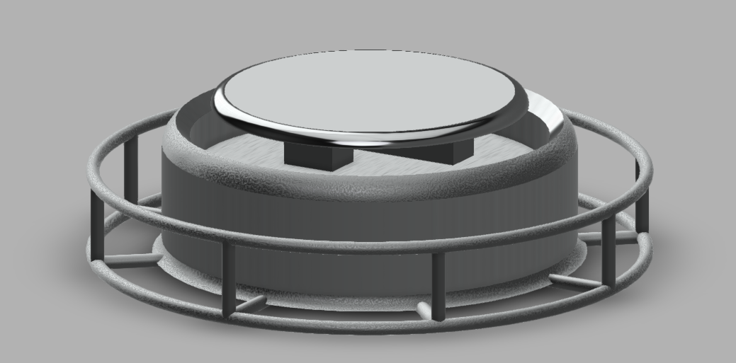
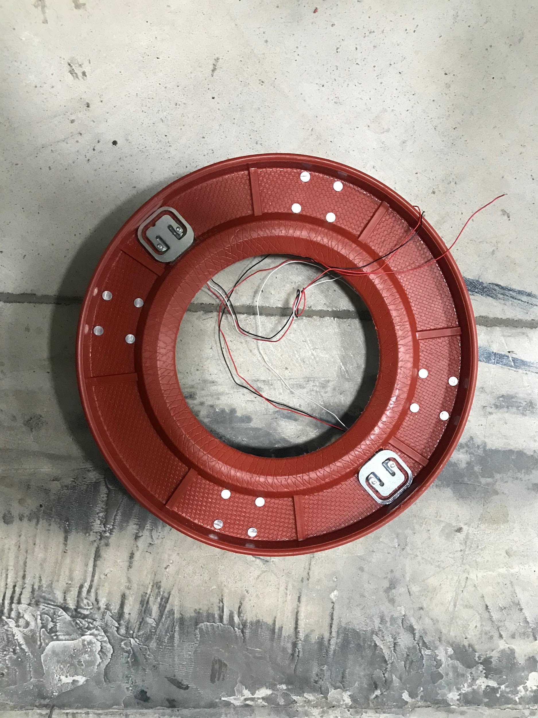
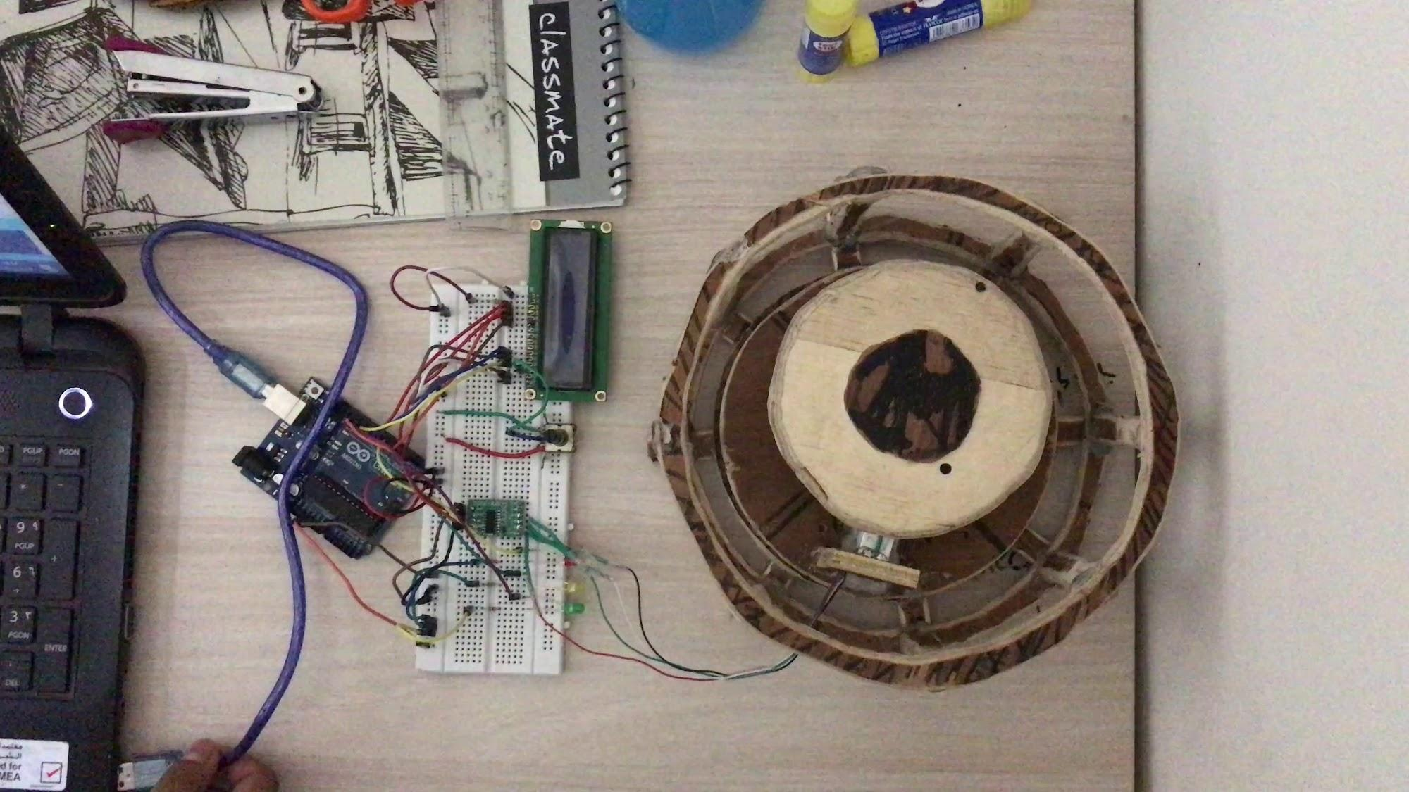
NirNaYAn: An Intelligent LPG Cylinder Stand

Slide 3
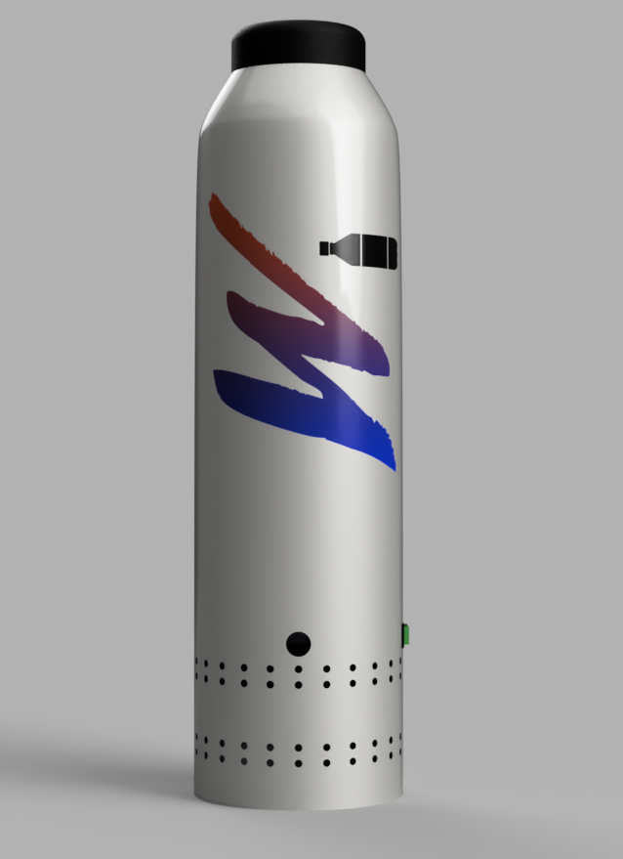
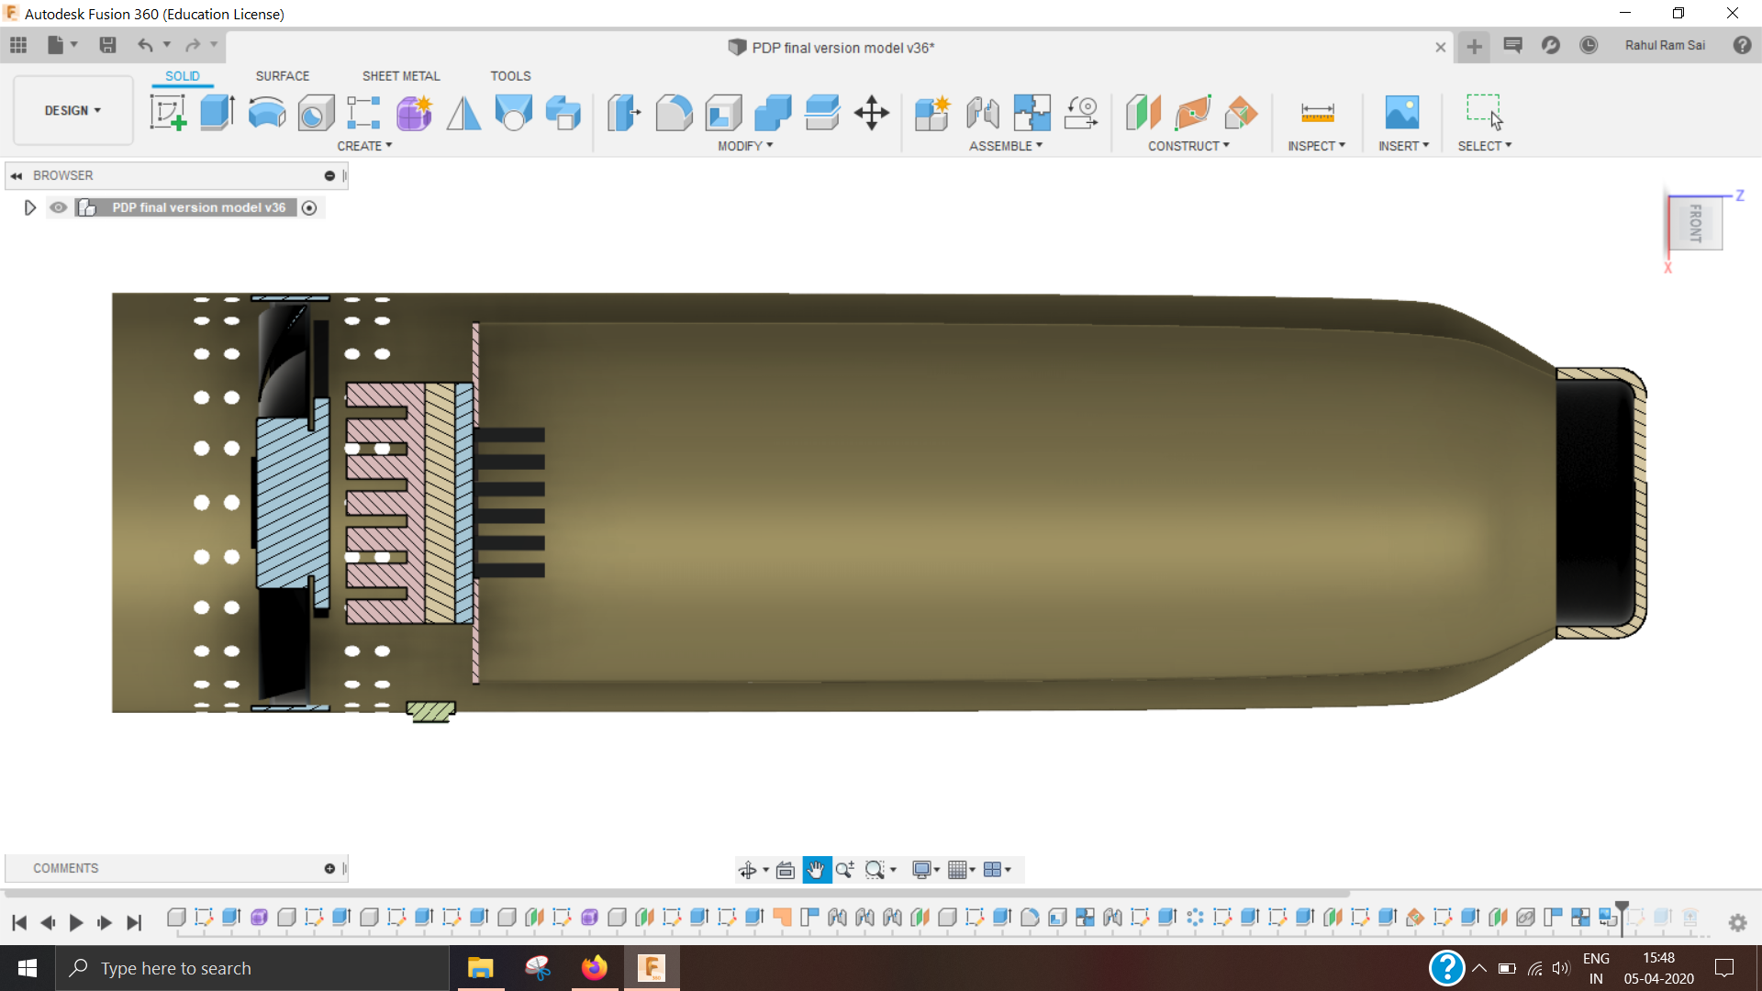
Water Bottle that can serve hot or cold

Slide 4

Domestic waste water treatment

Slide 5
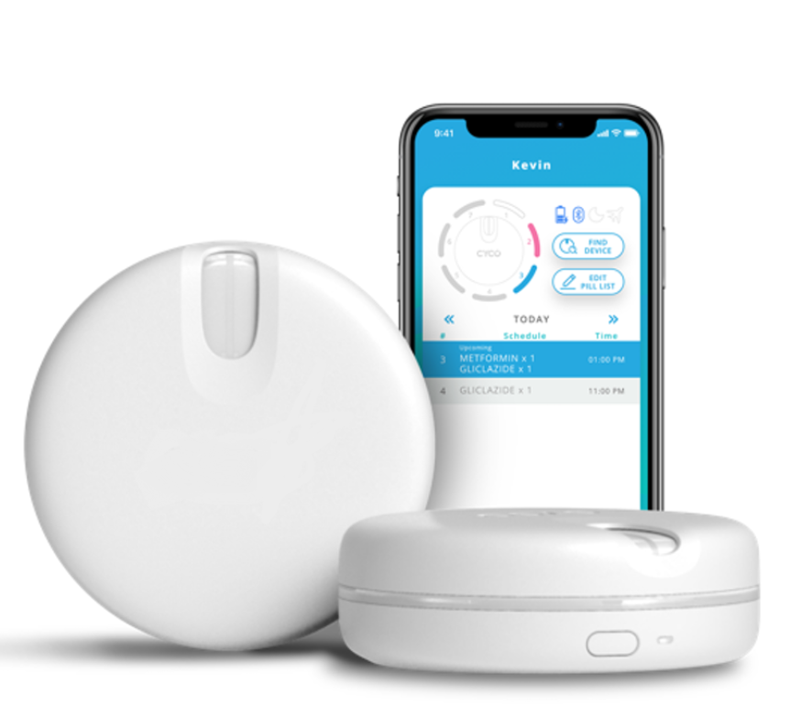
Smart pill box for TB patients

Slide 6
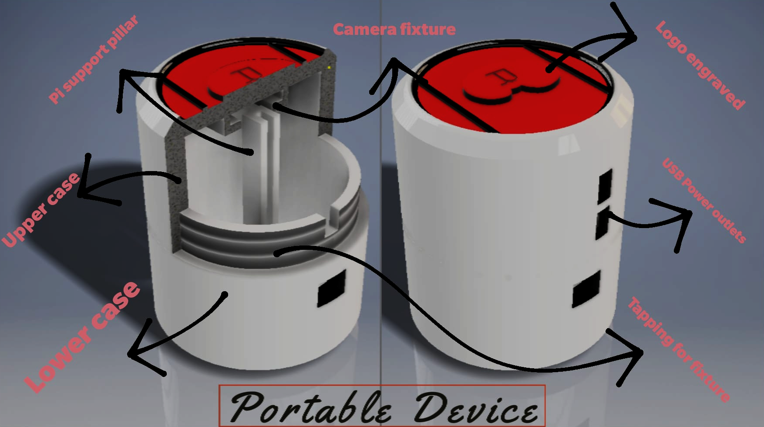
Ren.AI: A diagnostic device for Chronic Kidney Disease

Slide 7
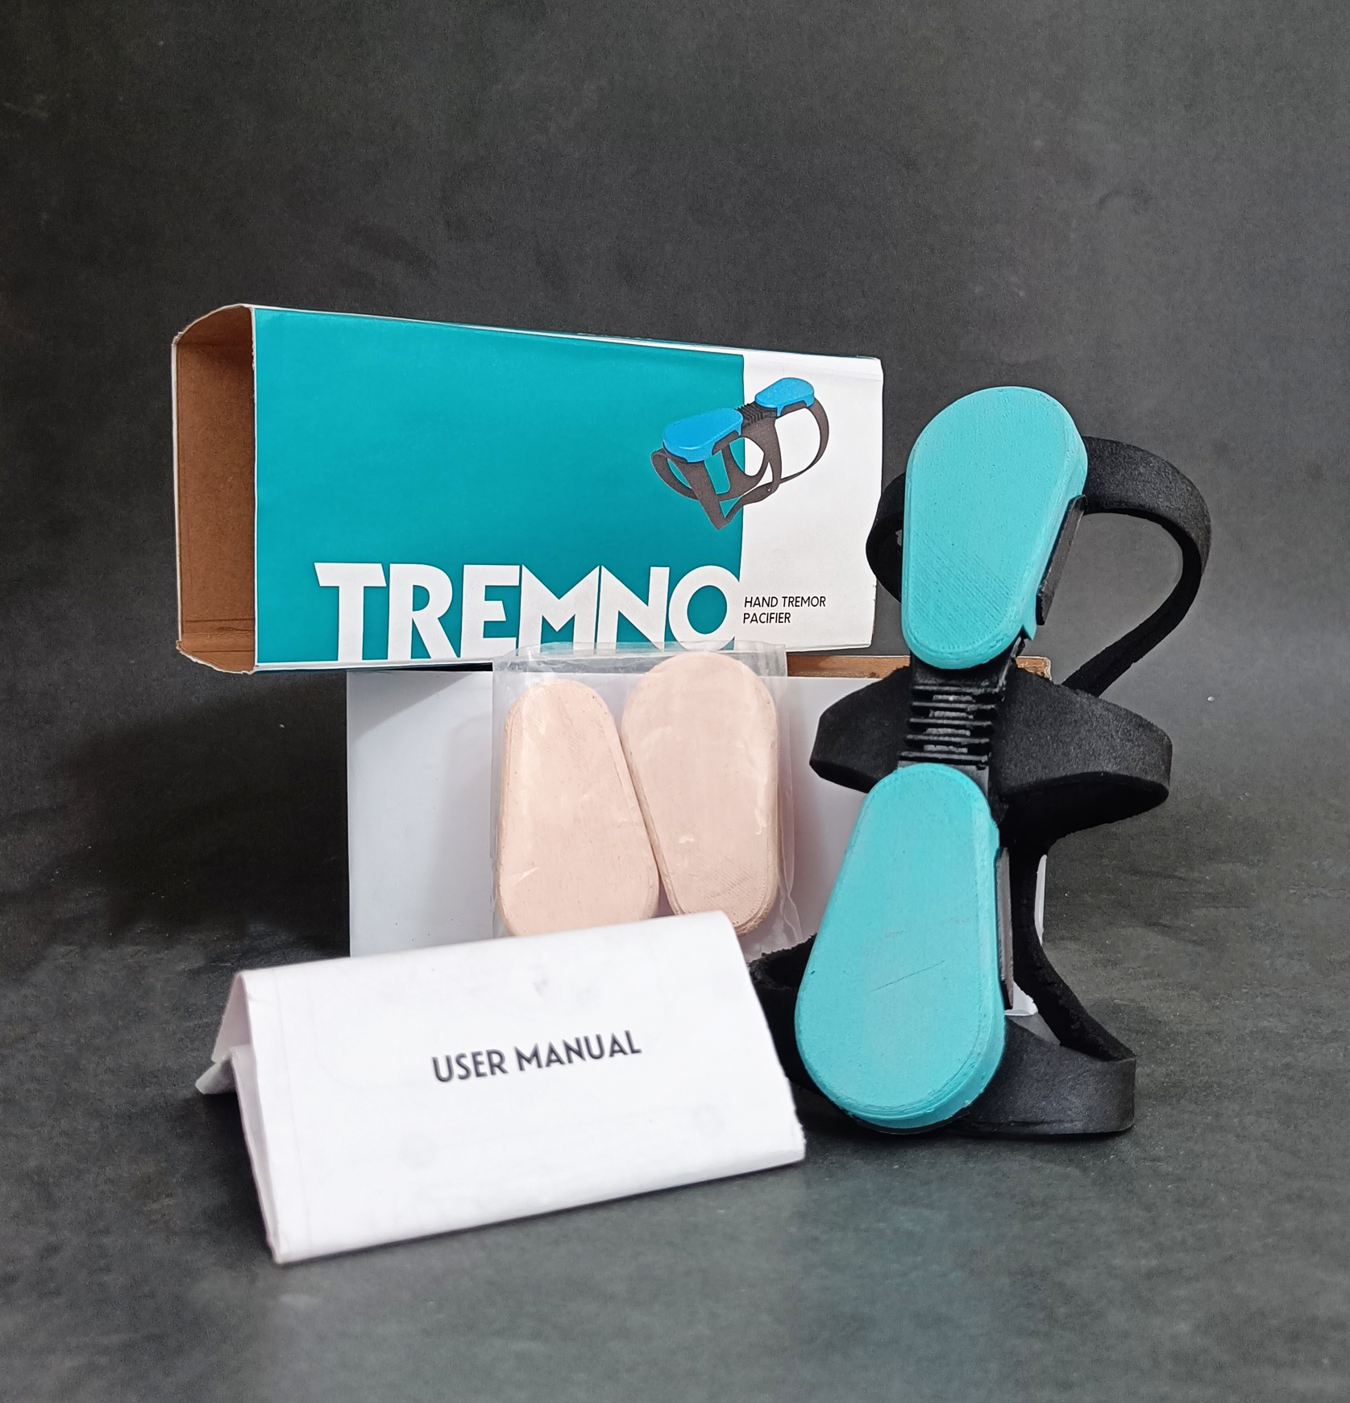
Tremno: Assistive device for arresting hand tremor

